Slide 1
Strengthening of damaged PSC bridge girders with Carbon Fibre Reinforced Polymer “CFRP” System
S. N Agarwal, GM/SER
K. C Swami, CBE/WR
Avinash Kumar, Dy. CE/D/WR

Slide 2
BRIDGE No. 114 (4X18.3m) on Khan River

Slide 3
Salient Features of Bridge No. 114
Span Configuration:- 4X18.3m
Superstructure:-Twin PSC girders with RCC deck Slab
Section –Godhra-Ratlam (Ratlam Division of WR)
Year of Construction -1958-60
Wt of one Span – 145 MT
Depth of Girder – 2130 mm
Loading Standard – BGML
Height of bridge (bottom of girder – Bed Level) -14.0m

Slide 4
Defects identified and Action Taken
Multiple vertical structural cracks found in girders
(mainly originating from bottom)
Other deteriorations in slab and girders also noticed.
Cracks were active (opening & closing)under traffic
Speed reduced to 20 kmph in March-2014
Tell tales were provided

Slide 5
Defect:- Vertical Flexural Cracks

Slide 6
Visible Cracks in Web of PSC girder

Slide 7
Tests carried out before strengthening
(i) Rebound hammer test –
Compressive strength of concrete
Ultrasonic pulse velocity test –
homogeneity and quality of concrete, presence of voids, cracks etc.
(ii) Core test – Comp strength of concrete
(iii) Tension test – Tensile Strength of Prestressing wire
(iv) Concrete Scanning System – used for locating prestressing cables and
finding their size.
Load tests for measurement of deflection using LVDT– to compare pre and post strengthening results-
Test for measurement of natural frequency using accelerometer– to compare pre and post strengthening results

Slide 8
Results of NDT tests
Span No. | Average of UPV readings (km/sec) | Average comp strength Rebound Hammer test (Mpa)
Span -2 | 3.42 | 54.3
Span-4 | 3.40 | 51.6
Pulse Velocity Value (Km/sec) | Concrete Quality
Above 4.5 | Excellent
3.5-4.5 | Good
3.0-3.5 | Medium
Below 3.0 | Doubtful

Slide 9
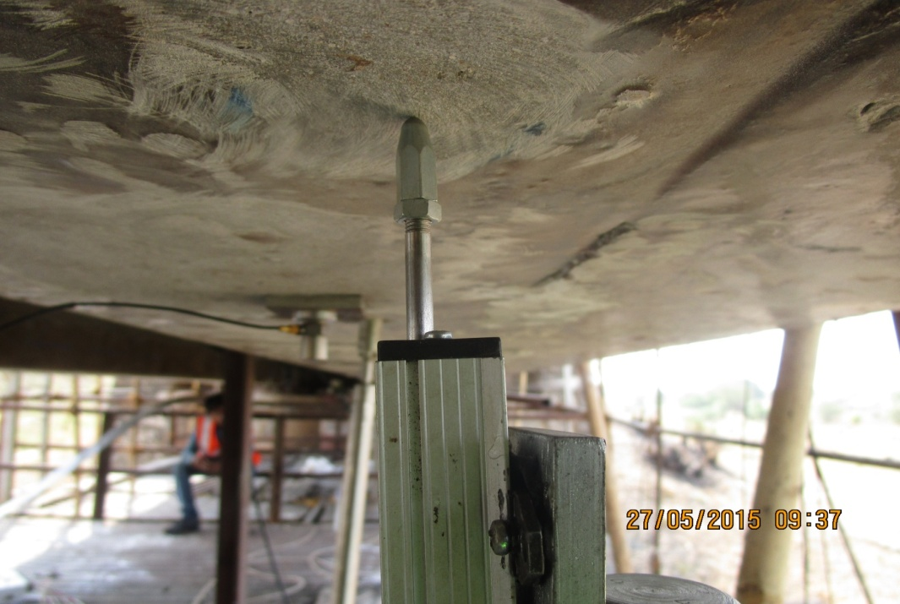
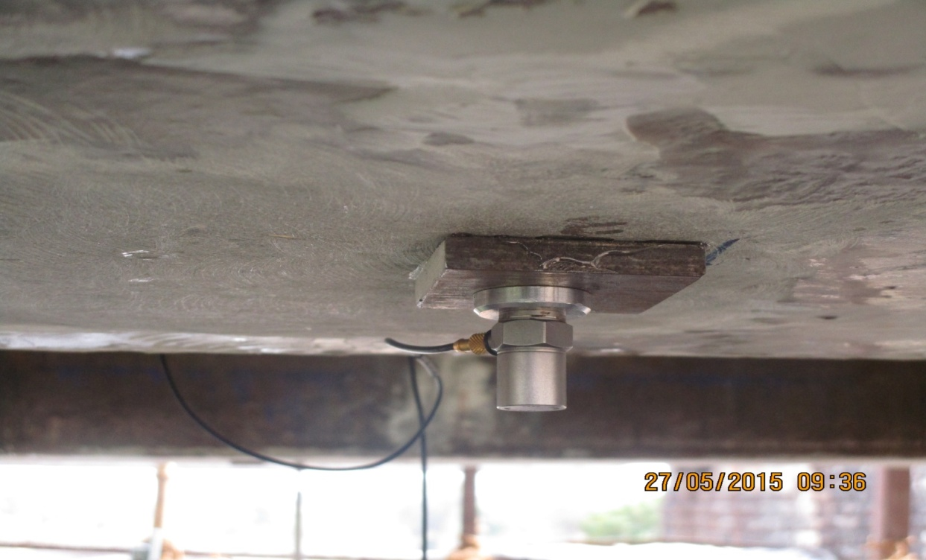
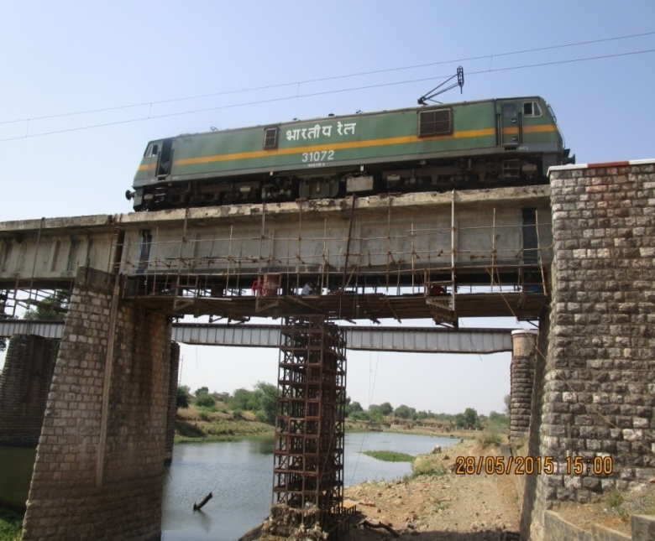
Deflection Test
Test For Natural Frequency
WAG 7 locomotive was used for load testing

Slide 10
Method of Strengthening
Preparatory Work
Repair of corrosion related deterioration
Patch Repair using Polymer Modified Mortar
Epoxy Grouting – Pressure injection of cracks
Installation of CFRP System
(i) Prestressed CFRP laminate - For enhancing Flexural stiffness
- 5 nos of 100 mm width and 2.4mm thick in each girder
(ii) CFRP sheet Wrapping
- For enhancing Shear Strength
- Provide additional bond strength to laminates
- 1 and 2 layers of 500 mm width 430GSM carbon fiber sheet 800mm c/c
Application of Protective Coating - to protect bonded CFRP from environmental effects

Slide 11
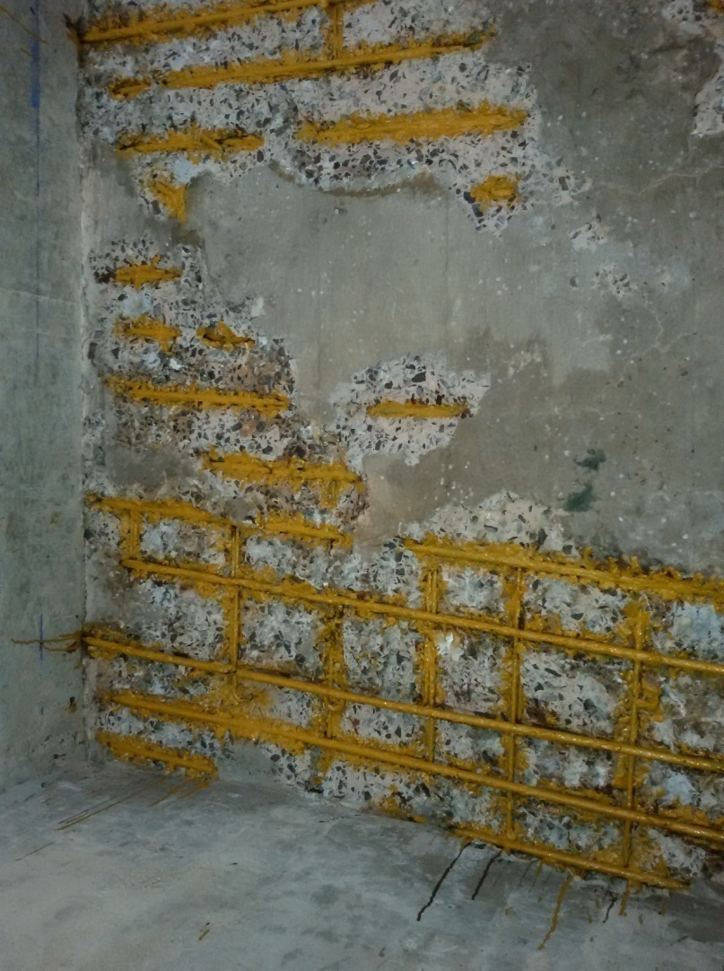
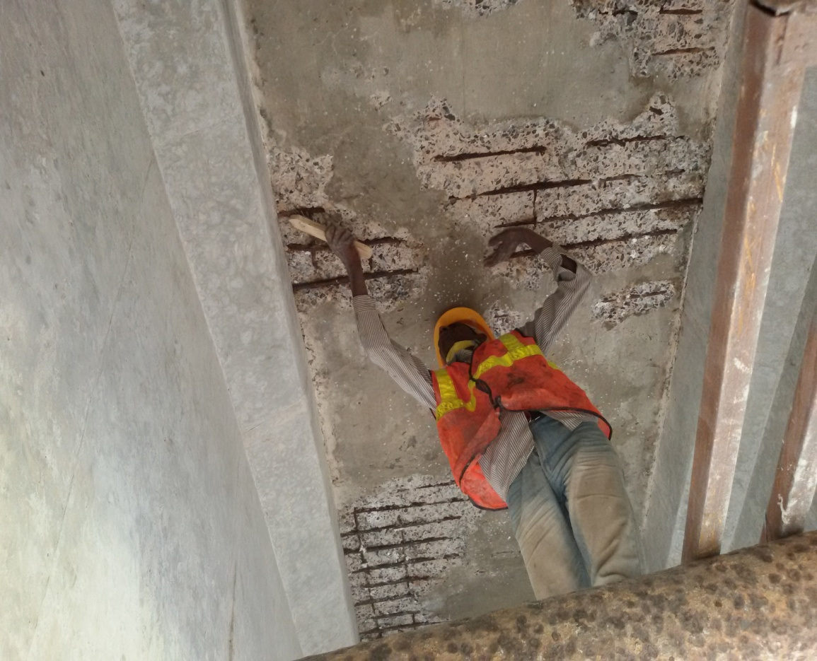
Repair of Corrosion related deterioration -Application of anticorrosive paint

Slide 12
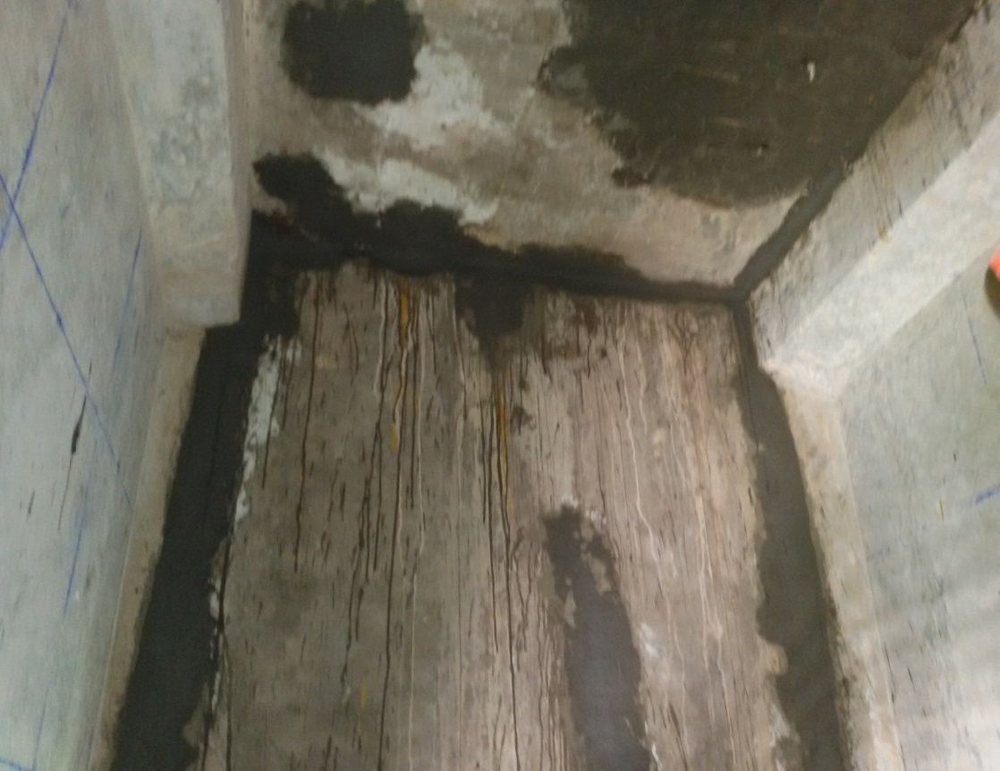
Application of Polymer modified mortar

Slide 13
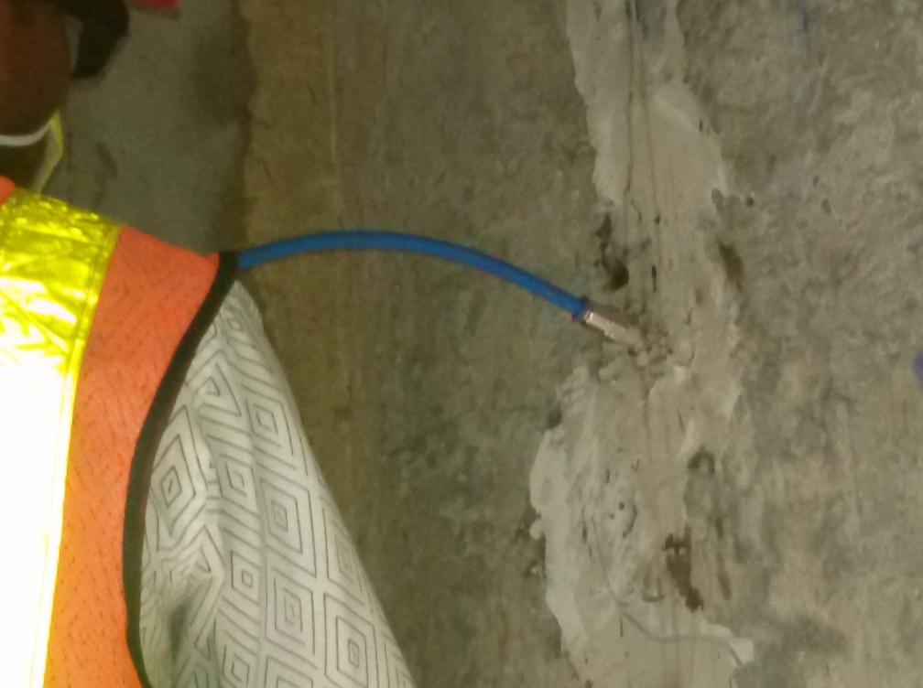
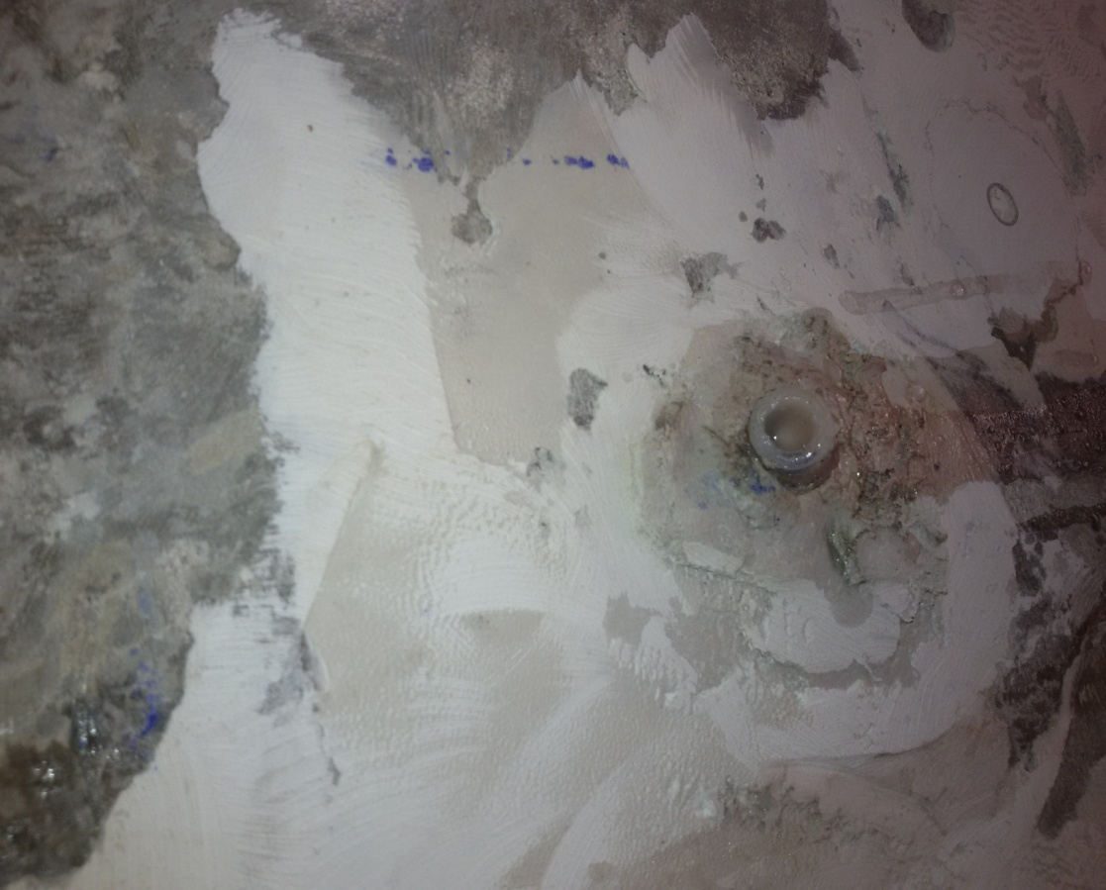
Injection in Cracks (Epoxy grouting)

Slide 14
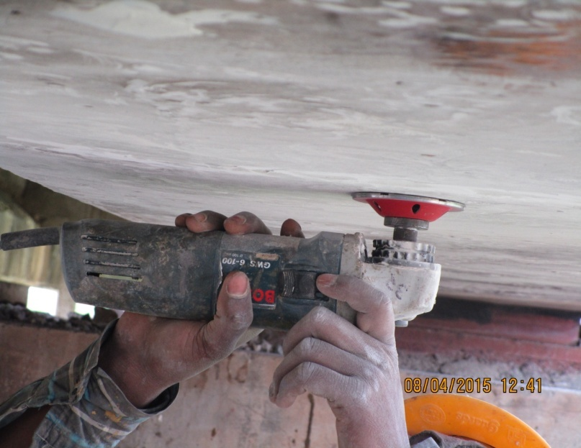
Surface Preparation

Slide 15
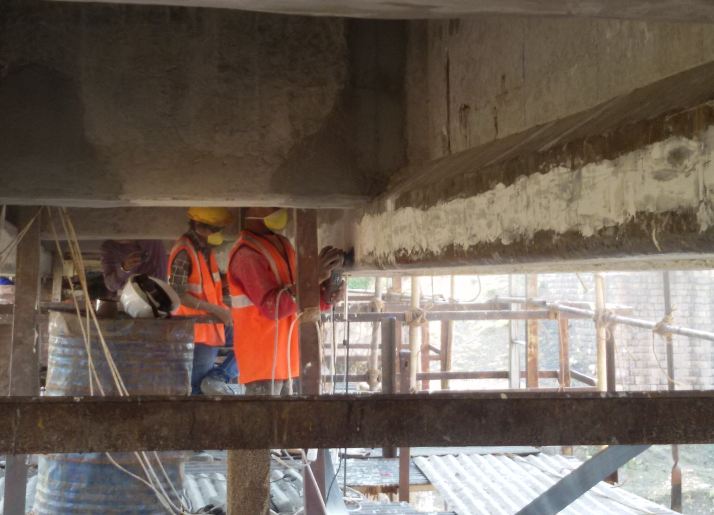
Application of Putty ( Removing surface undulation)

Slide 16
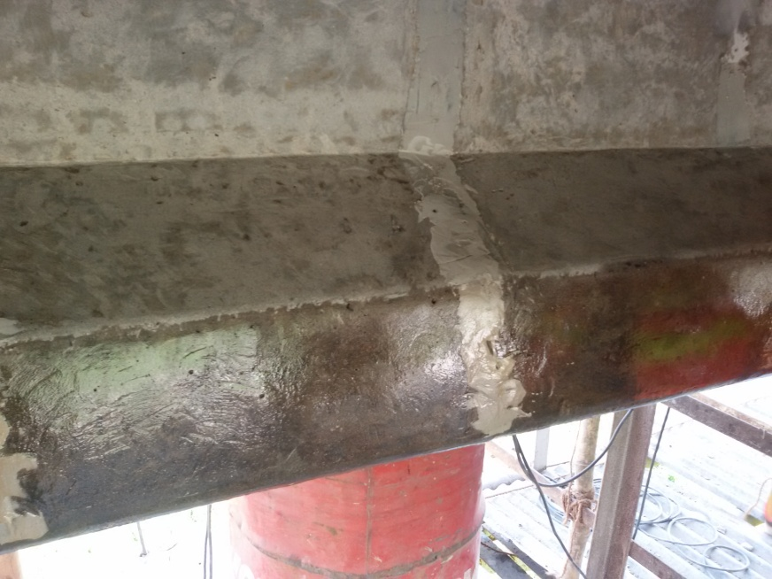
Application of Primer (Bonding Coat)

Slide 17
Installation of CFRP System
Application of CFRP laminates
Clamping Device
CFRP Laminate 100x2.4 mm
Hydraulic Jack
Cylinder Body
Anchor Plate
80 KN
Bottom Face of PSC Girder

Slide 18
RCC SLAB
PSC GIRDER
CFRP Laminate
CFRP Sheet 500 mm wide
Cross Section
RCC SLAB
800 mm c/c
PSC GIRDER
CFRP Laminate 100x2.4 mm
Elevation of PSC girder

Slide 19
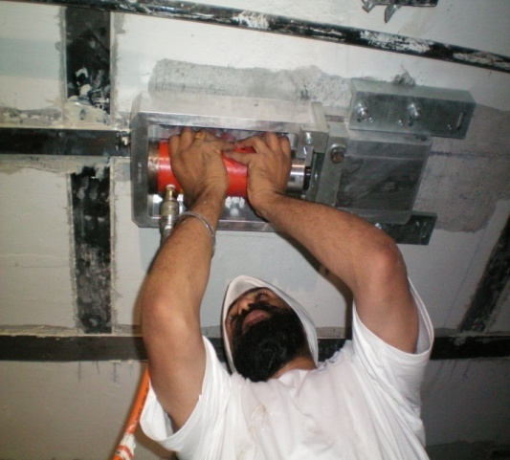
Fixing of Hydraulic Jack and application of prestressing force

Slide 21
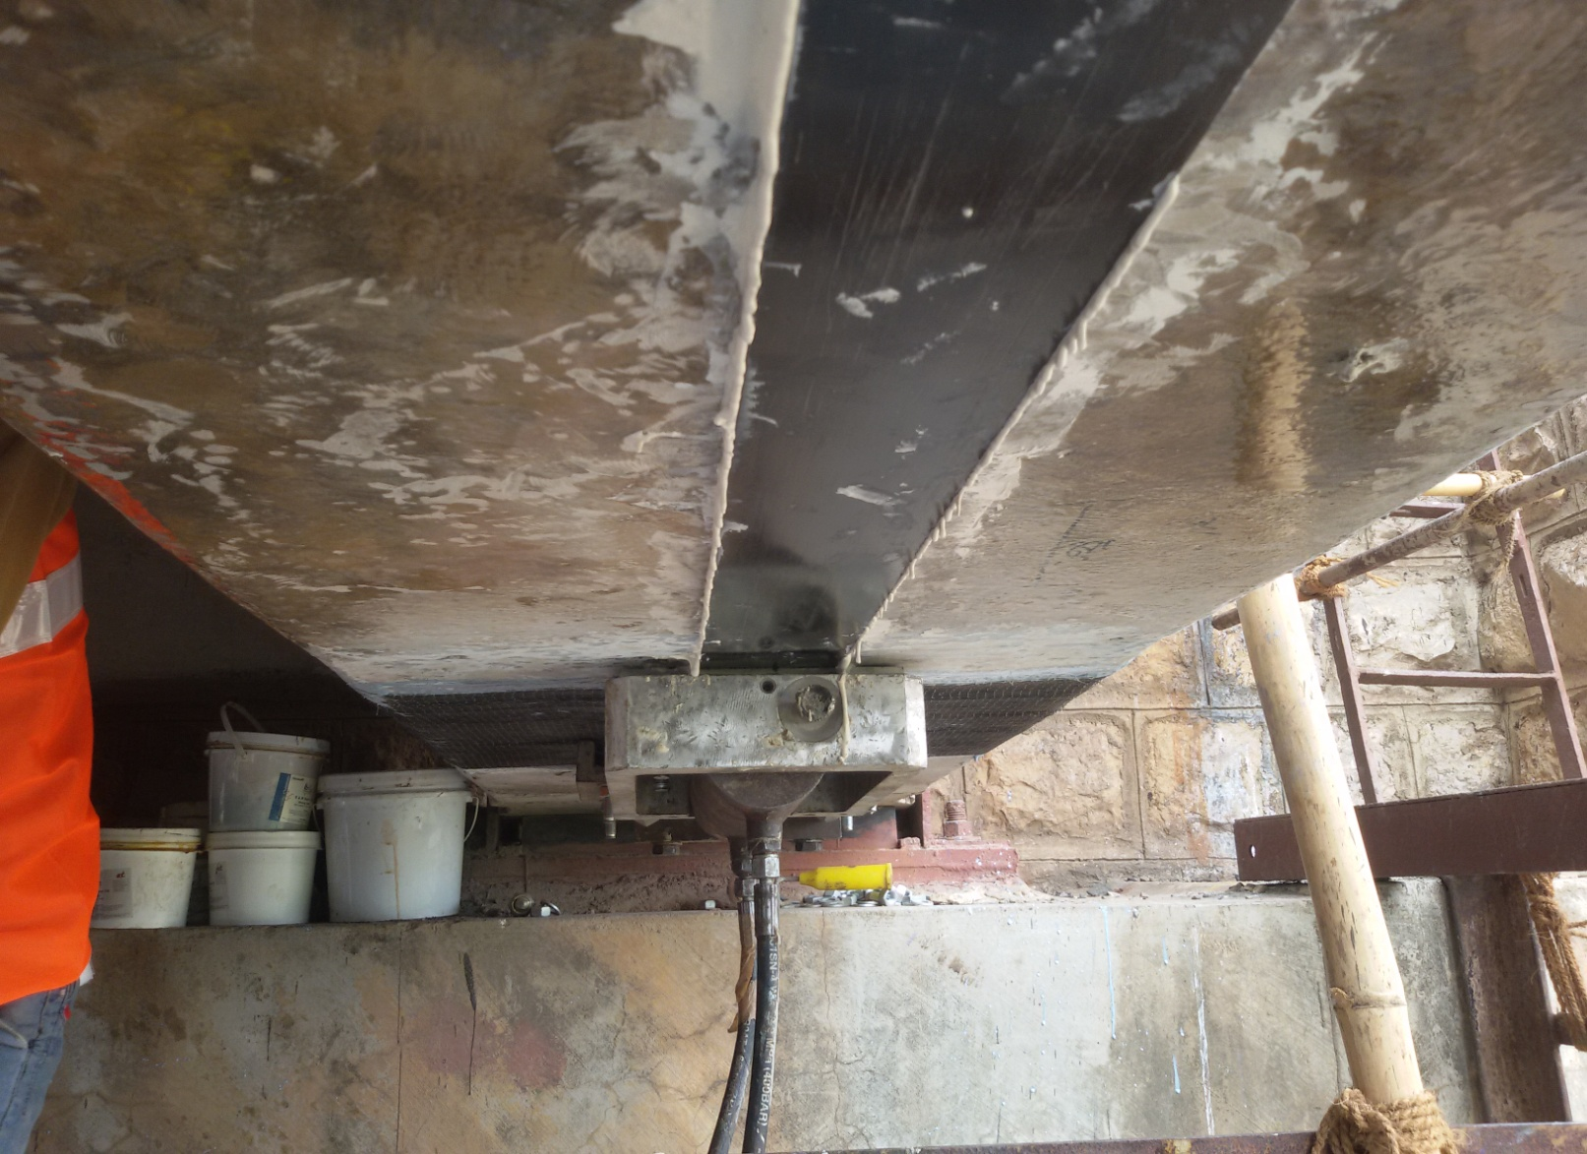
Pre stressing of laminate

Slide 22
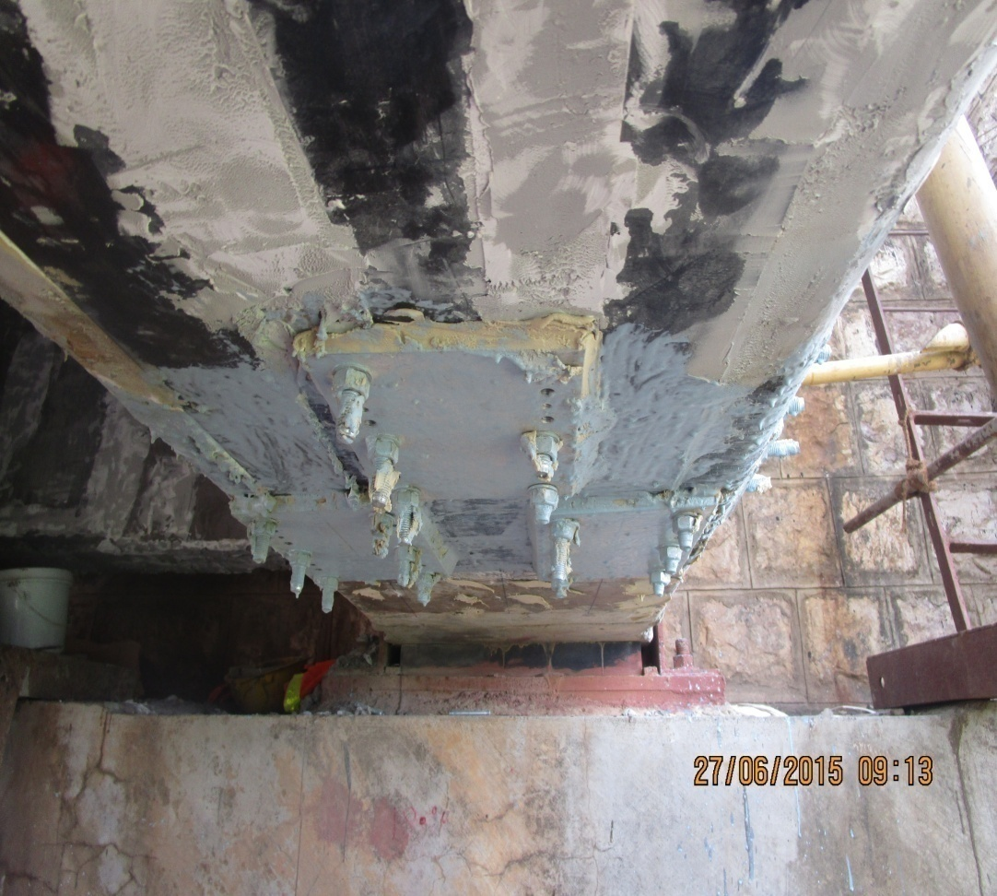
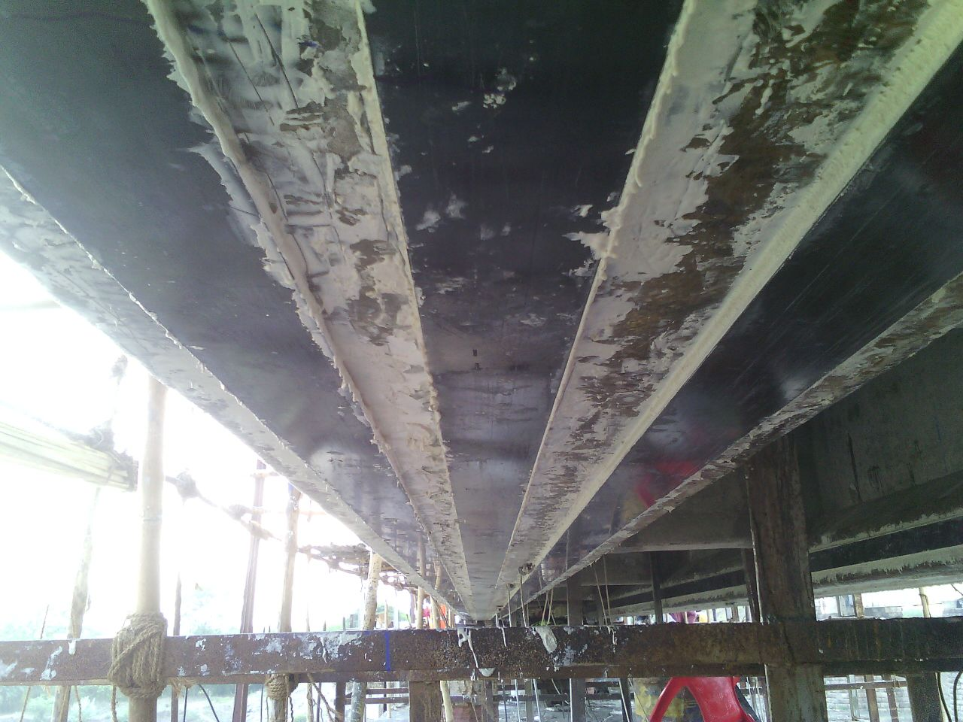
Pre stressed carbon laminates in bottom of girder

Slide 23
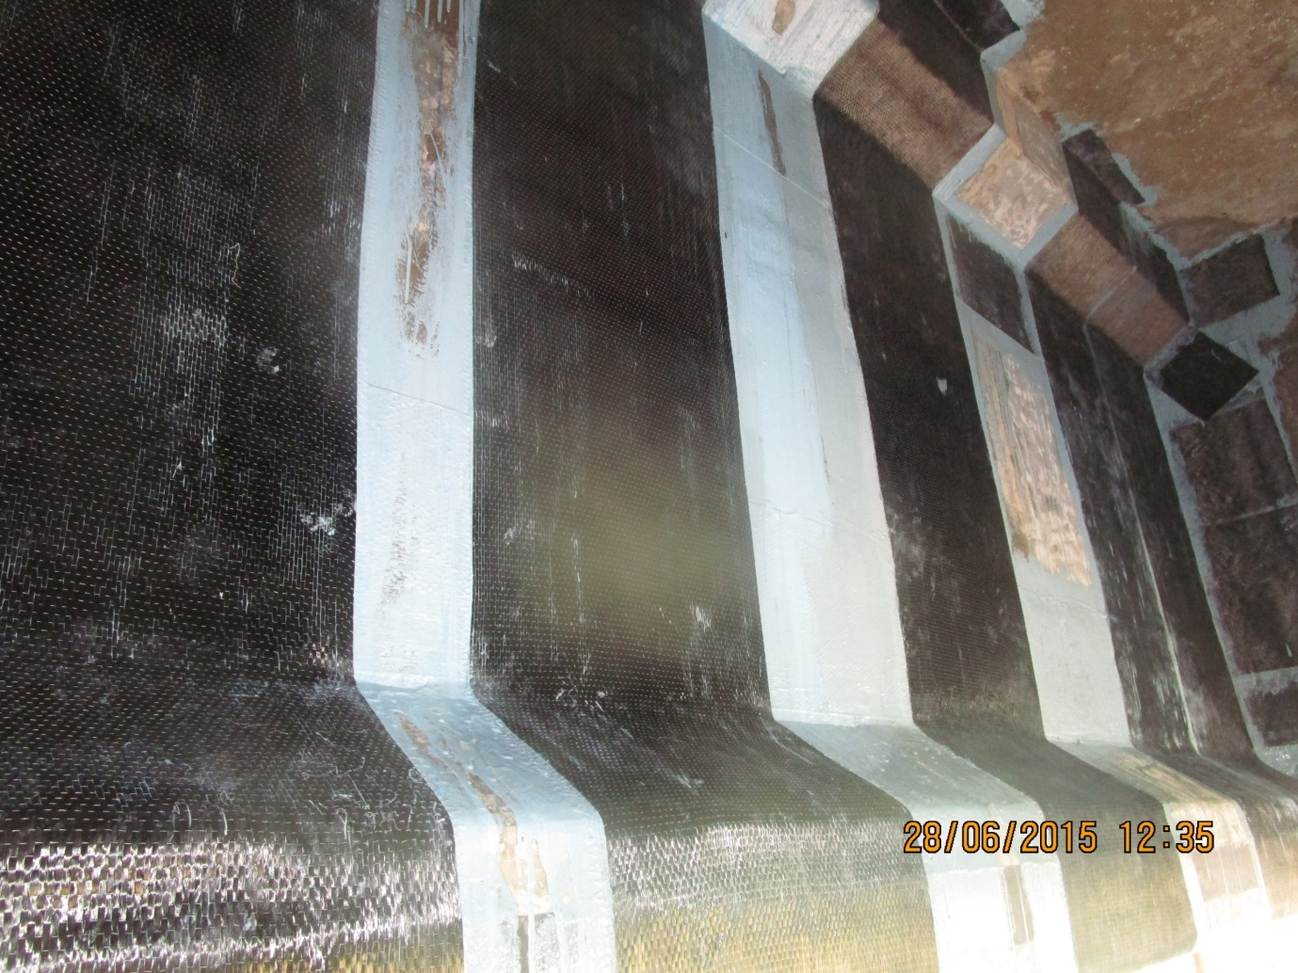
Carbon Fiber Wrapping

Slide 24
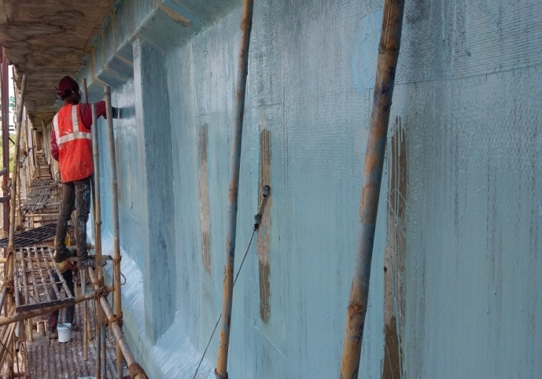
Carbon Fiber Wrapping (duly saturated with saturating resin)

Slide 25
Strengthened PSC Girder

Slide 26
Acceptance criteria
Cracks: - No further progression of cracks after rehabilitation.
Deflection:- Fifty to seventy percent of the excess deflection as compared to uncracked girder will be reduced
Natural frequency: - the excessive natural frequency will come within 25% of the value of uncracked girder.
Note:- In case natural frequency is already near to or within 25% of the natural frequency of uncracked girder, the respective above criteria cannot be applicable.

Slide 27
Effectiveness of Strengthened deck Deflection of girders at mid point for WAG-7 Loco
Span No. | Deflection in mm |  | % reduction | % recovery of excessive deflection | Remark
 | Before Strengthening | After Strengthening
1st, Uncracked Girder | 2.79 | -- |  |  | Excess deflection reduced more than 50%
2nd, Cracked Girder | 3.84 | 3.07 | 20.05 | 73.33
4th, Cracked Girder | 4.06 | 3.16 | 22.16 | 70.86

Slide 28
Effectiveness of Strengthened deck Natural frequency of Girders (in Hertz)
Span No. | Frequency in Hz |  | % Increase
 | Before Strengthening | After Strengthening
1st, Uncracked Girder | 9.58 | --
2nd, Cracked Girder | 8.64 | 9.29 | 7.52
4th, Cracked Girder | 8.44 | 8.70 | 3.08
Natural frequency of Cracked girders are already within 25% of the natural frequency of uncrackd girder.
However natural frequencies of repaired girders are more, which indicate that flexural stiffness has increased after repair.

Slide 29
Health Monitoring of Repaired Girders Deflection of repaired girders in mm with time
Span | Date of recordings
 | 07.07.15 | 10.08.15 | 26.10.15 | 29.01.16 | 23.08.16 | 22.10.16
2nd | -- | 3.07* | 3.13 | 3.11 | 3.10 | 3.07
4th | 3.16* | 3.11 | 3.17 | 3.12 | 3.14 | 3.12
*-values just after repair

Slide 30
Effectiveness of Strengthened deck
Deflection of girder at mid point ( For WAG7 Load) in mm
Span No. | Before Strengthening | After Strengthening
 |  | Load Test | FE Analysis
2nd (distressed girder) | 3.84 | 3.07 | 3.10
4th (distressed girder) | 4.06 | 3.16 | 3.21

Slide 31
Effectiveness of Strengthened deck
Deflection of girder at mid point ( For WAG7 Load) in mm
Span No. | Before Strengthening | After Strengthening
 |  | Load Test | FE Analysis
2nd (distressed girder) | 3.84 | 3.07 | 3.10
4th (distressed girder) | 4.06 | 3.16 | 3.21

Slide 32
Design Details (material properties)
Items | Details
Grade of concrete, girder | M35 (verified from NDT tests and core sample)
Grade of concrete, deck slab | M20 (verified by NDT tests)
No of cables in each girder | 6
No of strands in a cable | 12
Diameter of one strand | 8 mm
Ultimate strength of cable | 1600 N/mm² (from testing)

Slide 33
Material properties of CFRP system
CFRP Laminate |  |  | CFRP Dry sheet
Width | 100 mm |  | Width | 500 mm
Thickness | 2.4 mm |  | Thickness | 0.25 mm
Modulus of Elasticity | 150 GPa |  | Modulus of Elasticity | 230 Gpa
Limiting Strain | 0.012 |  | Limiting Strain | 0.014
Limiting Stress | 1800 N/mm² |  | Limiting Stress | 3220 N/mm²

Slide 34
Design Consideration
(i) Design philosophy
-ACI 440.2R-08 has been followed
- Published by American Concrete Institute
Design was Proof checked by Prof K.M Bajoria of IIT/Mumbai
(ii) Design Flexural strength determined based on Strain compatibility, Internal force equilibrium and Controlling mode of failure.
(iii) The Strengthened Girders have been designed to satisfy Ultimate limit state as well as serviceability limit state.

Slide 35
Probable Failure mode
Crushing of concrete in compression before yielding of prestressing steel and rupture of laminates
Yielding of prestressing steel in tension followed by rupture of laminates
Yielding of steel followed by concrete crushing
Debonding of CFRP laminates from concrete substrate

Slide 36
Flexural strength – Ultimate limit state
Loading standard considered 25t-2008
Design Flexural strength = 18241 KN-m
Applied factored Moment = 17587 KN-m
< 18241 KN-m
( Less than Design Flexural moment, hence OK)

Slide 37
Stresses in Service condition
Compressive stress in concrete should be less than 0.45fc
Comp stress = 6.4 Mpa < 7.2 Mpa
Stress in prestressing wire should be less than 0.72fpu to avoid yielding of steel in service
Stress in steel = 705 Mpa < 1140 Mpa
Stress in CFRP laminates should be less than 0.55ffu to avoid creep rupture under sustained load and fatigue due to cyclic stress
Stress in laminate = 410 Mpa < 990 Mpa

Slide 38
Advantages of prestressing laminates
Induce comp stresses in bottom of girder
May close pre existing cracks and increase stiffness
Laminate made active to participate to carry load due to DL+SIDL – 0.22 % strain (more utilization)
Improve serviceability and durability of girders
Increase the ultimate moment of resistance by delaying failure mode associated with delamination as the ends are anchored.

Slide 39
Conclusions
The use of CFRP laminates increases the flexural stiffness and natural frequency of the cracked prestressed girders.
Proper CFRP repair scheme can be designed by following provisions of ACI-440-2R for capacity enhancement and desired mode of failure of repaired PSC girders.
Results of load tests after strengthening are in good agreement with the results obtained from FE analysis.
The deflection of repaired girders are almost constant after passing more than one year – thus proved an effective method of strengthening of cracked PSC girders
First time implemented in Indian Railway and proved very promising, effective and economical for organization like Railway where work has to be done under traffic or a traffic block of 2-3 hours –traffic can’t be stopped or diverted

Slide 40
THANK YOU

